Slide 1
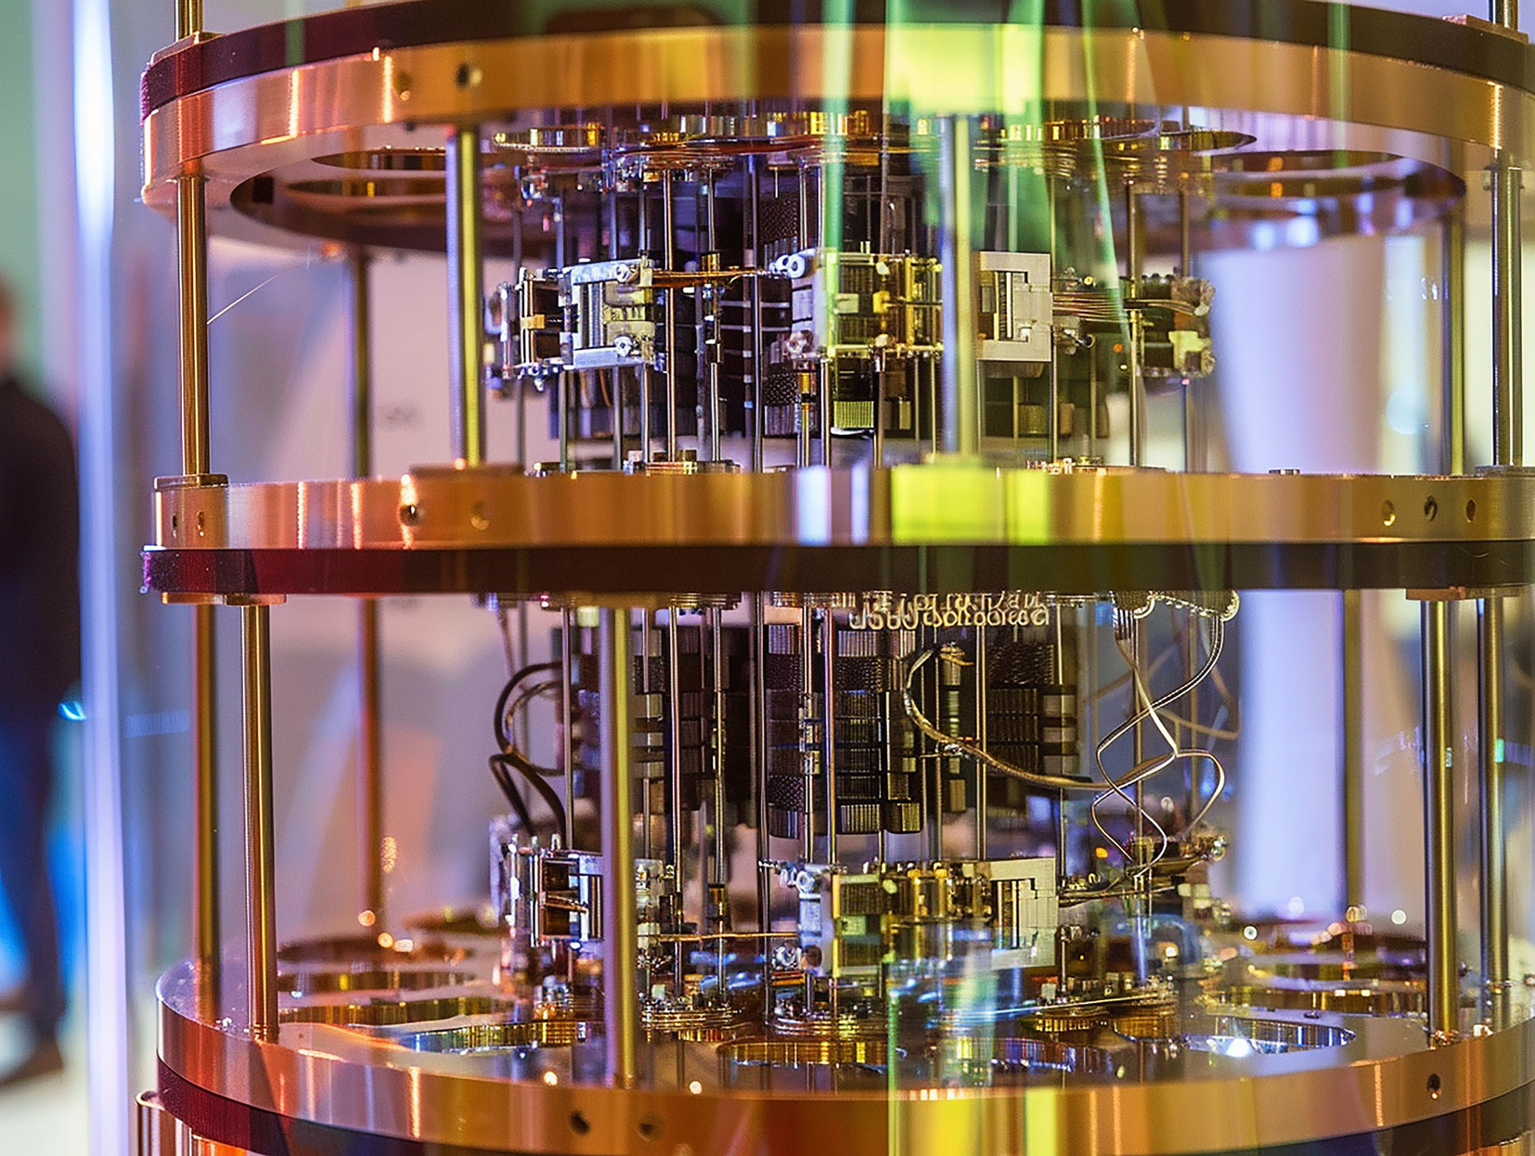

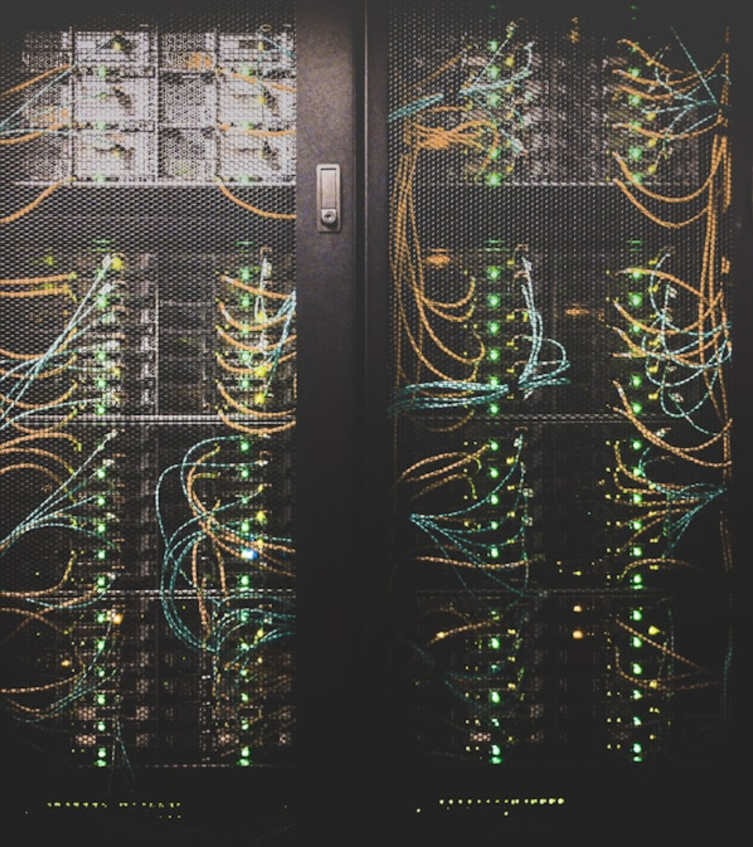

CRYSTALS
Kyber & Dilithium
Post-Quantum Cryptography

Slide 2
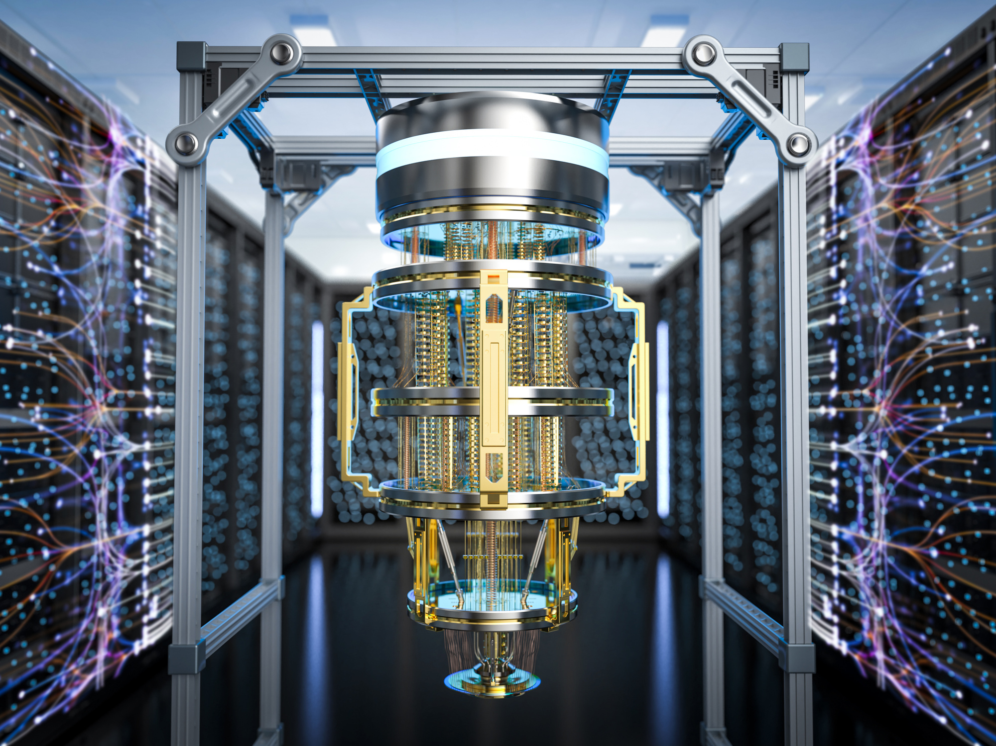
Need For Post-Quantum Cryptography
Quantum computers threaten current public key systems such as RSA and ECC because Shor algorithm can break them in practical time. Post Quantum Cryptography builds new algorithms that remain secure even if large quantum computers exist.
Lattice based cryptography is one of the most trusted approaches. It relies on hard mathematical problems in high dimensional lattices instead of integer factorization. CRYSTALS Dilithium is a lattice based digital signature scheme selected by NIST for standardization

Slide 3
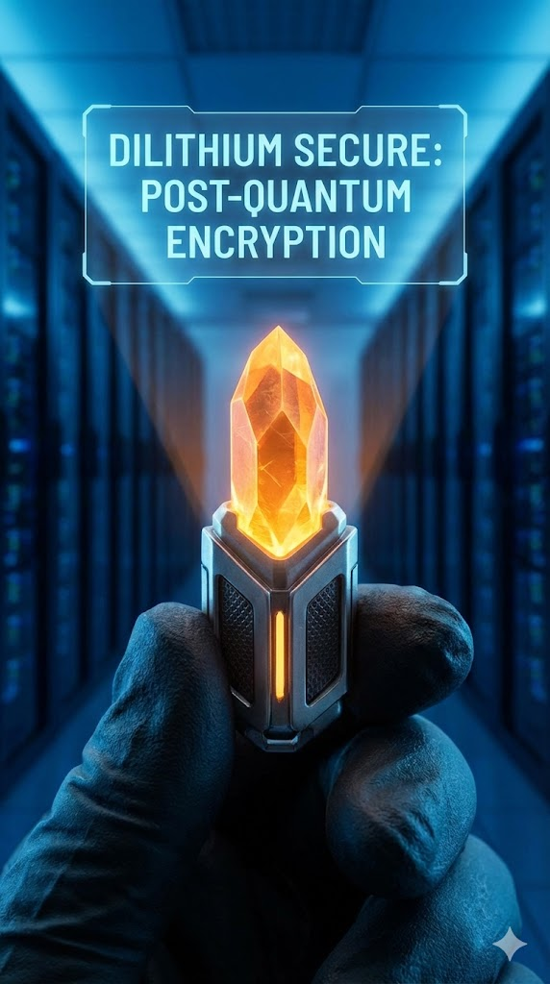
CRYSTALS ML-DSA Dilithium
Dilithium
  Purpose is digital signatures and authentication
  Used to sign messages and verify identity
  Requires repeated polynomial transforms during signing
  Focus on strong integrity and non repudiation

Slide 4
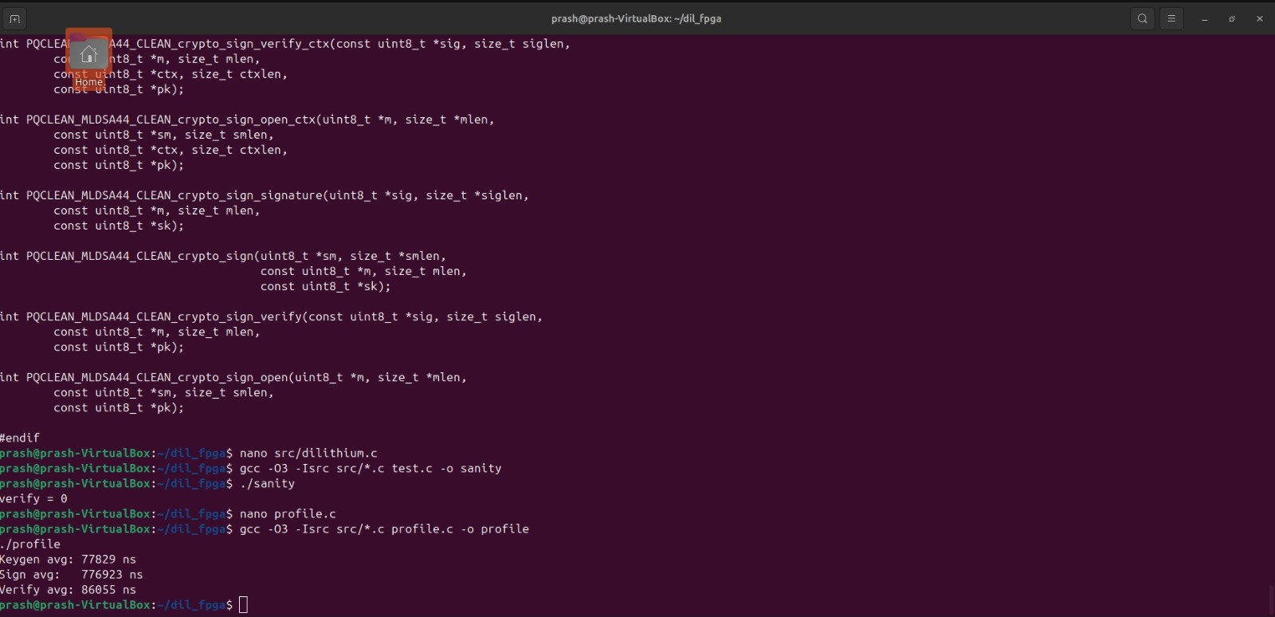
Output & Deliverables
Key Generation, Signing and Verification Time Statistics Of Dilithium in PYNQ Z2

Slide 5
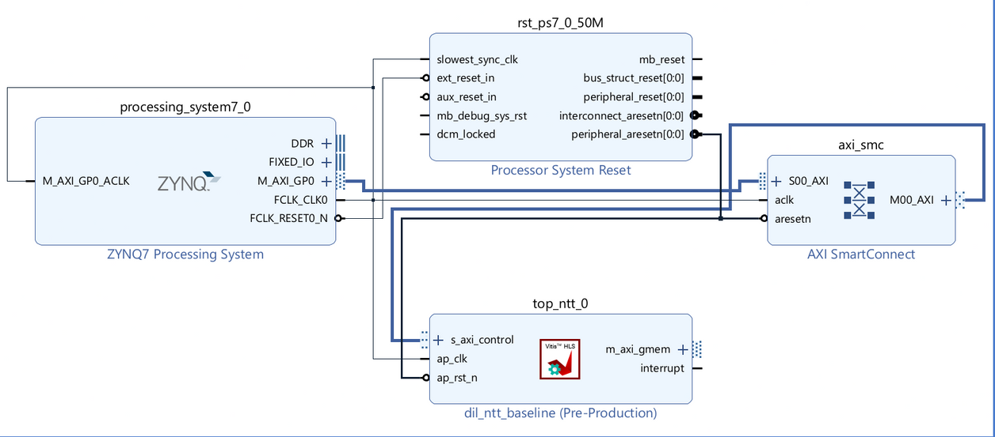
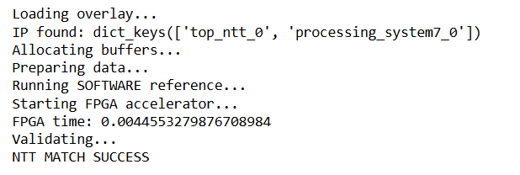
Output & Deliverables
IP Block Diagram of NTT Engine Of Dilithium in PYNQ Z2

Slide 6
Output & Deliverables
NTT Successful Completion and Time Taken is 4.5ms

Slide 7

CRYSTALS ML-KEM Kyber 512
  Purpose is key encapsulation and key exchange
  Used to establish shared secret keys
  Optimized for encryption style operations
  Smaller ciphertext and faster decapsulation

Slide 8
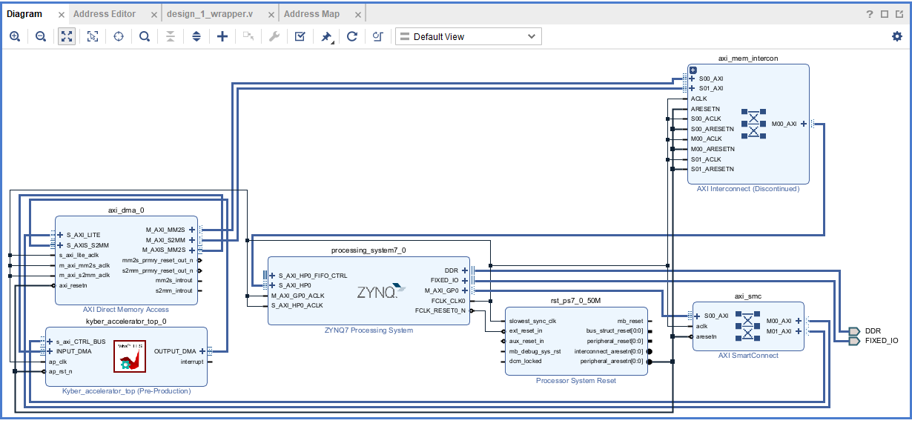
Output & Deliverables - KYBER
IP Block Diagram Of KYBER - 512

Slide 9
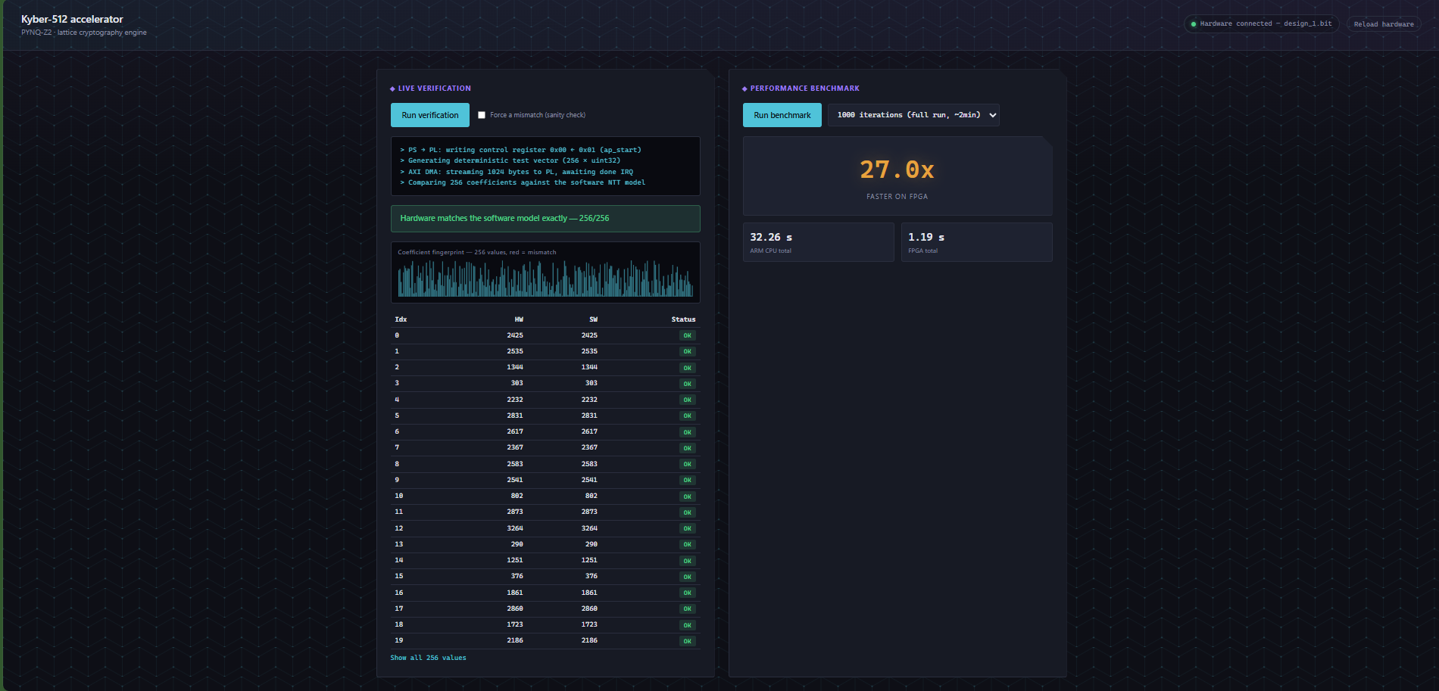
Output & Deliverables - KYBER
Successful Implementation of KYBER - 512 on PYNQ Z2

Slide 10
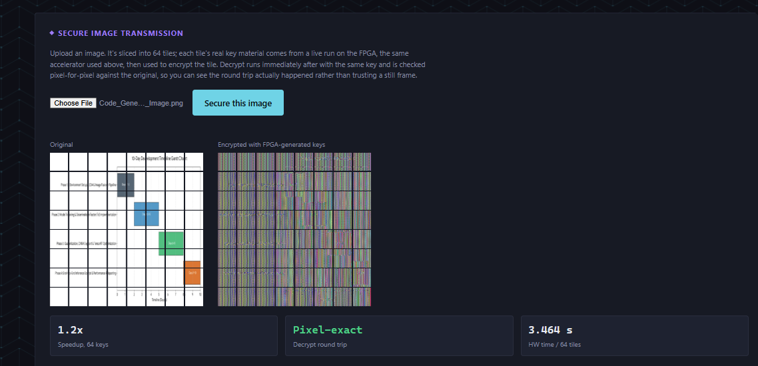
Output & Deliverables - KYBER
KYBER – 512 securing Images using slicing and encryption Technique

Slide 11
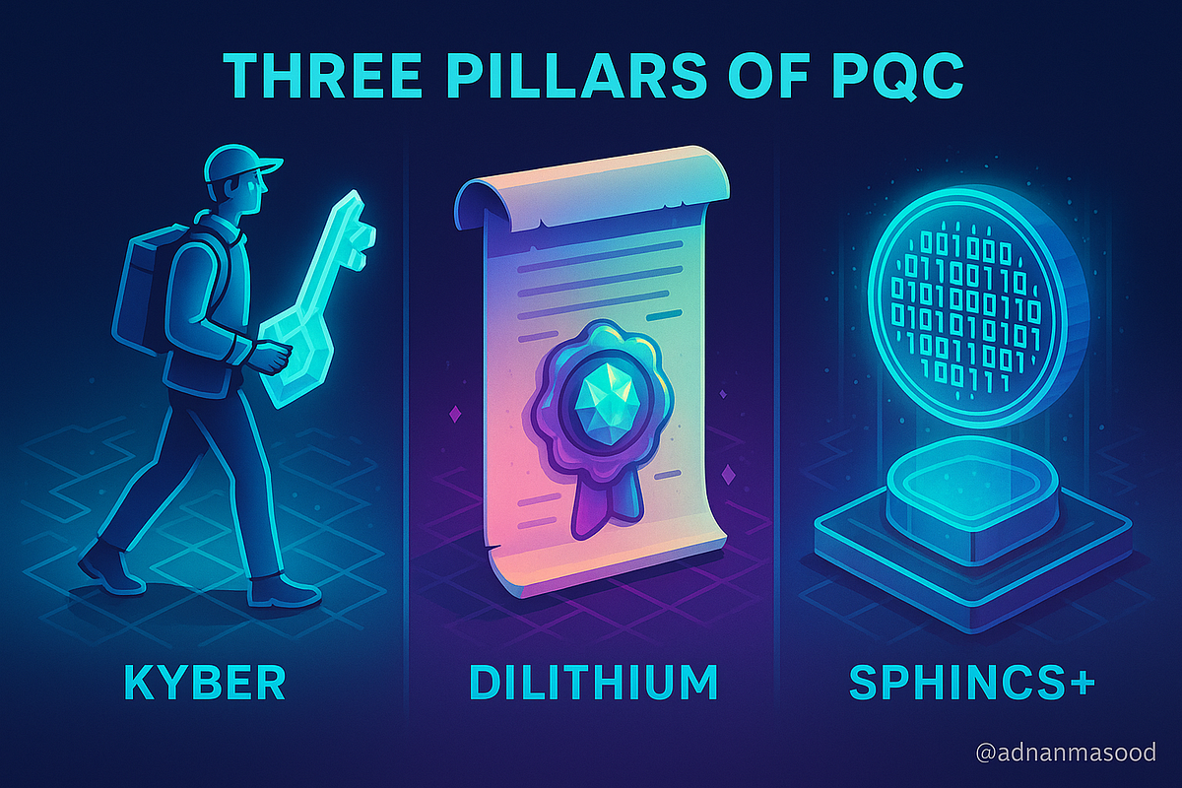
Kyber vs Dilithium
Kyber
  Purpose is key encapsulation and key exchange
  Used to establish shared secret keys
  Optimized for encryption style operations
  Smaller ciphertext and faster decapsulation
Dilithium
  Purpose is digital signatures and authentication
  Used to sign messages and verify identity
  Requires repeated polynomial transforms during signing
  Focus on strong integrity and non repudiation

Slide 12
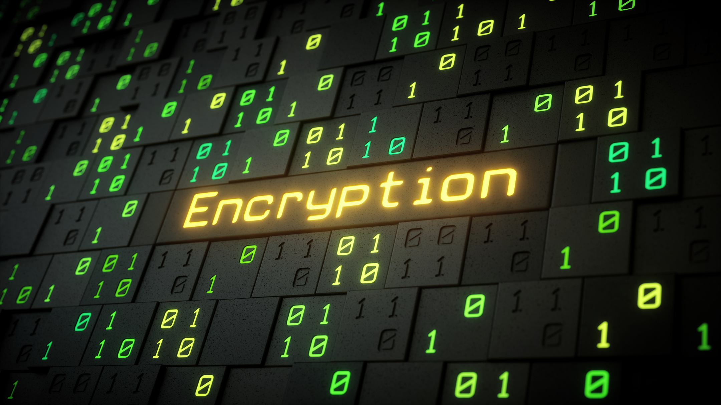

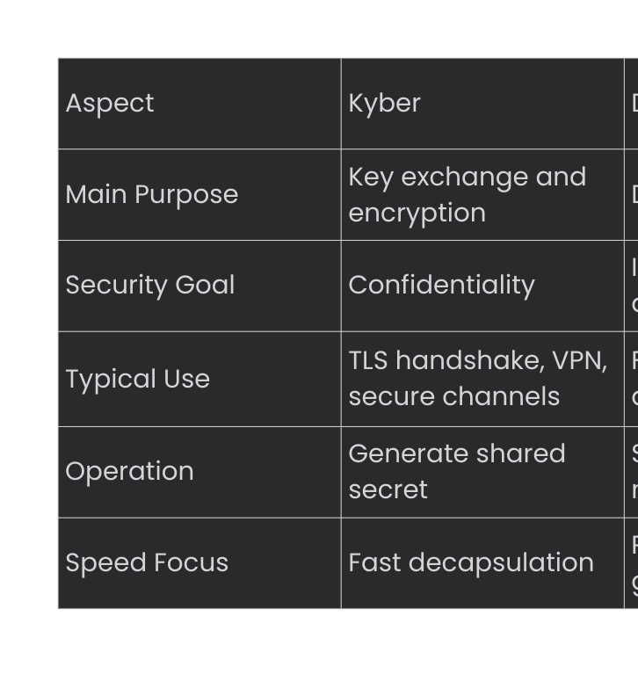
Kyber vs Dilithium Use Cases

Slide 13
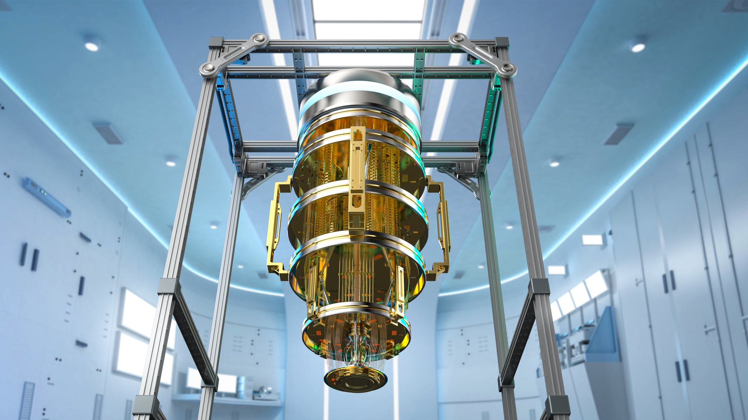
Future Scope
Hardware Acceleration
  Build dedicated accelerators for NTT, hashing, and sampling on embedded platforms
  Use FPGAs and custom SoCs for real time post quantum authentication
  Deploy in IoT nodes, smart cards, edge processors, and secure gateways
Standardization and Interoperability
  Align with maturing NIST standards and certification processes

